Slide 1

TITLE : SPPU RESULT ANALYSIS
GUIDED BY : Priti Malkhede
Asst. Professor
Department of Computer Engineering
Presented By
Ritesh Gaikwad (69)
Nikhil Rai (74)
Mayur Gulve (73)
Vishal Gaikwad (76)
Department of Computer Engineering
JSPM’s Bhivrabai Sawant Institiute of Technology and Research

Slide 2
INTRODUCTION
The current result analysis system at our college relies on manual data entry and excel sheets to process and analyze student results. This process is time-consuming, error-prone, and lacks scalability. To address these challenges, we propose the development of an online system named SPPU Result Analysis, which aims to automate the result analysis process and improve overall efficiency.

Slide 3
EXISTING SYSTEM
Result Data Collection : The college collects the result data for each student, including marks obtained in different subjects, attendance records, and any other relevant information. This data is usually provided by faculty members or exam administrators.
Manual Data Entry : The collected data is manually entered into an Excel spreadsheet. Each student's information, including subject marks, is entered row by row in the spreadsheet.
Data Analysis : Once the data is entered, the college performs various analysis tasks using Excel's formulas and functions. This may include calculating averages, generating reports, identifying top-performing students, and other statistical analysis as required.
Report Generation : Based on the analyzed data, reports are created manually using Excel. These reports may include subject-wise performance, overall performance, class-wise analysis, and other relevant metrics.

Slide 4
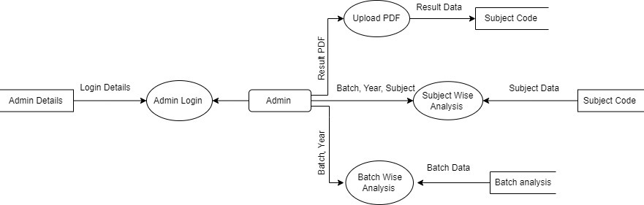
SYSTEM ARCHITECTURE

Slide 5
ALGORITHM
Upload Result PDF
Start
Take the Result PDF, Result PDF Batch and Result PDF Year
Convert PDF File into CSV file using convertAPI
Fetch the data from CSV file and Store the data in MySql Database
Stop
Subject Wise Analysis
Start
Take Batch, Year and Subject
Fetch the Subject Data from the MySql Database and Display the Topper list, Fail Student list, Pass Student list and All Student List of that subject.
Stop
Batch Wise Analysis
Start
Take the Batch and Year from the user
Fetch the Batch Data of that year from MySql database and Display the Batch Analysis
Stop

Slide 6
SYSTEM REQUIREMENTS
HTML, CSS
Convert API
XAMPP
VS Code
PHP
Bootstrap

Slide 7
PROJECT MODULES
Upload PDF
In this module we take the pdf from the user and extract the data using convertAPI and then we insert the data in My SQL database.
Suject Wise Analysis
In this module we take the batch, year and subject name and show the topper students list, pass students list, fail students list and all students list.
Batch wise Analysis
In this module we take the batch and year and then show the all subject analysis in a single excel sheet.

Slide 8
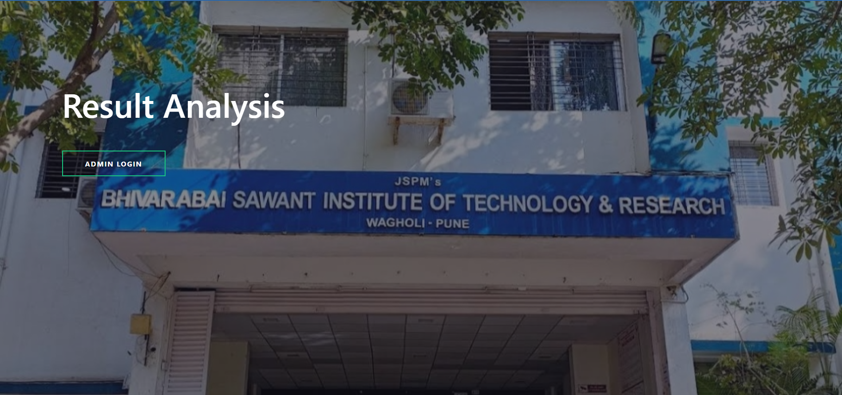
ANALYSIS

Slide 9
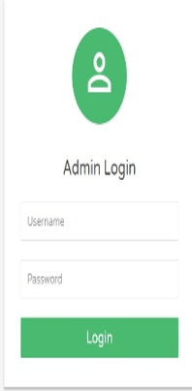

Slide 10
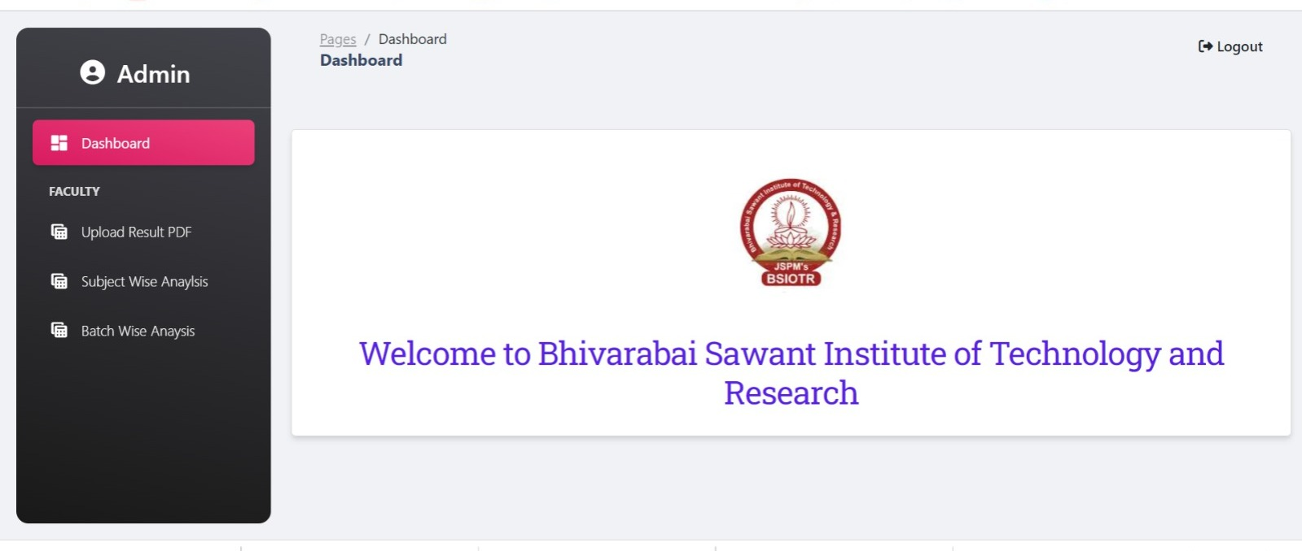

Slide 11
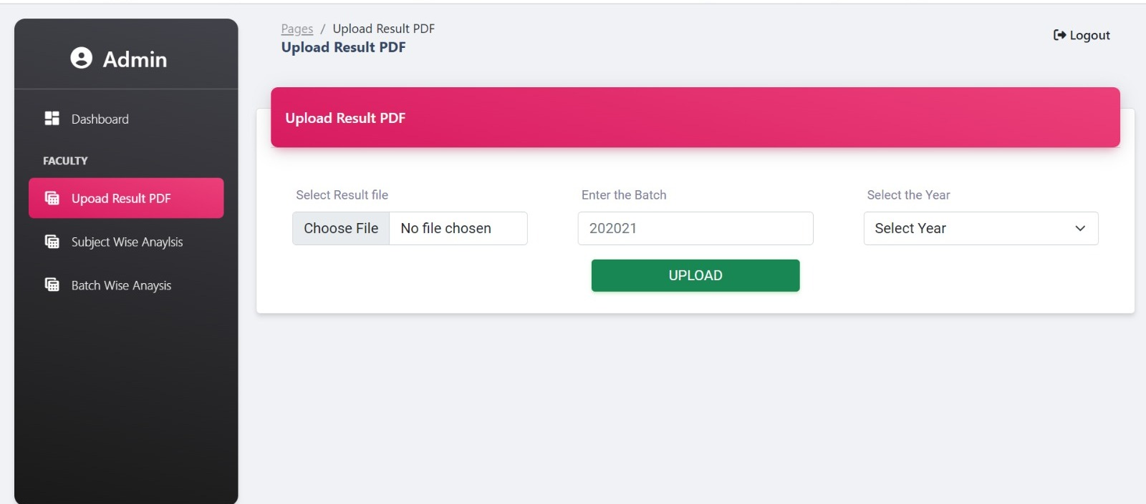

Slide 12
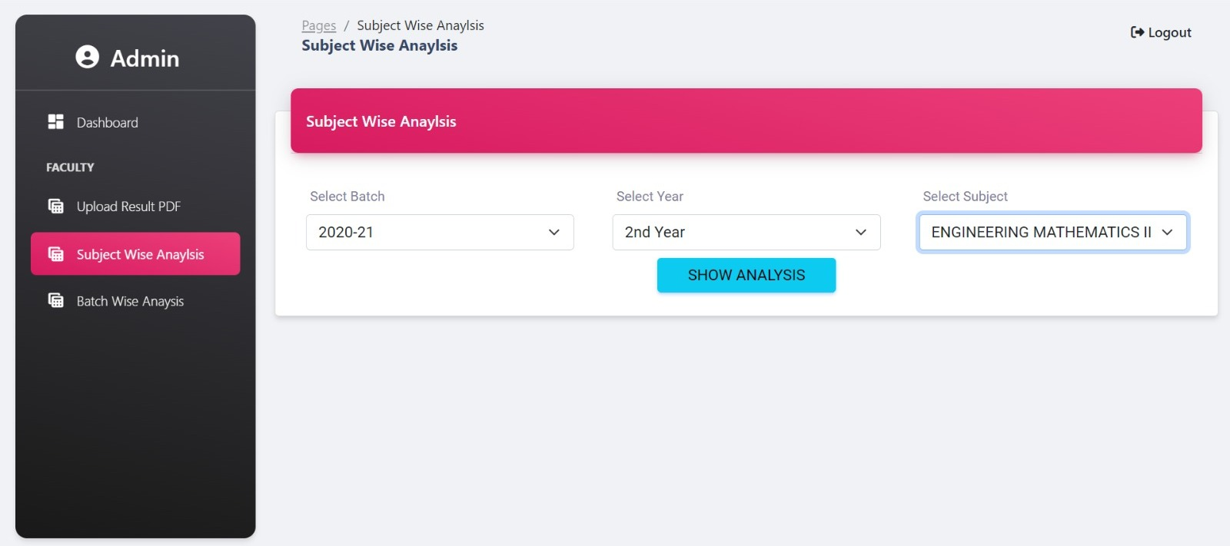

Slide 13
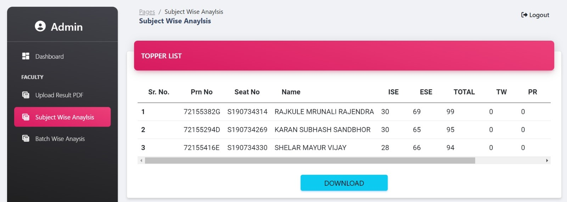

Slide 14
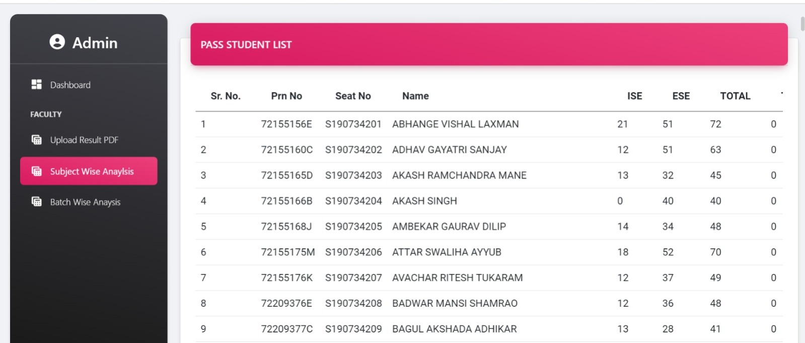

Slide 15
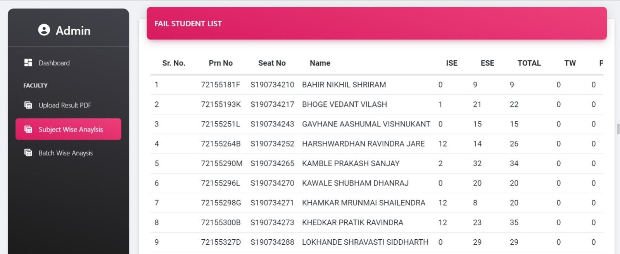

Slide 16
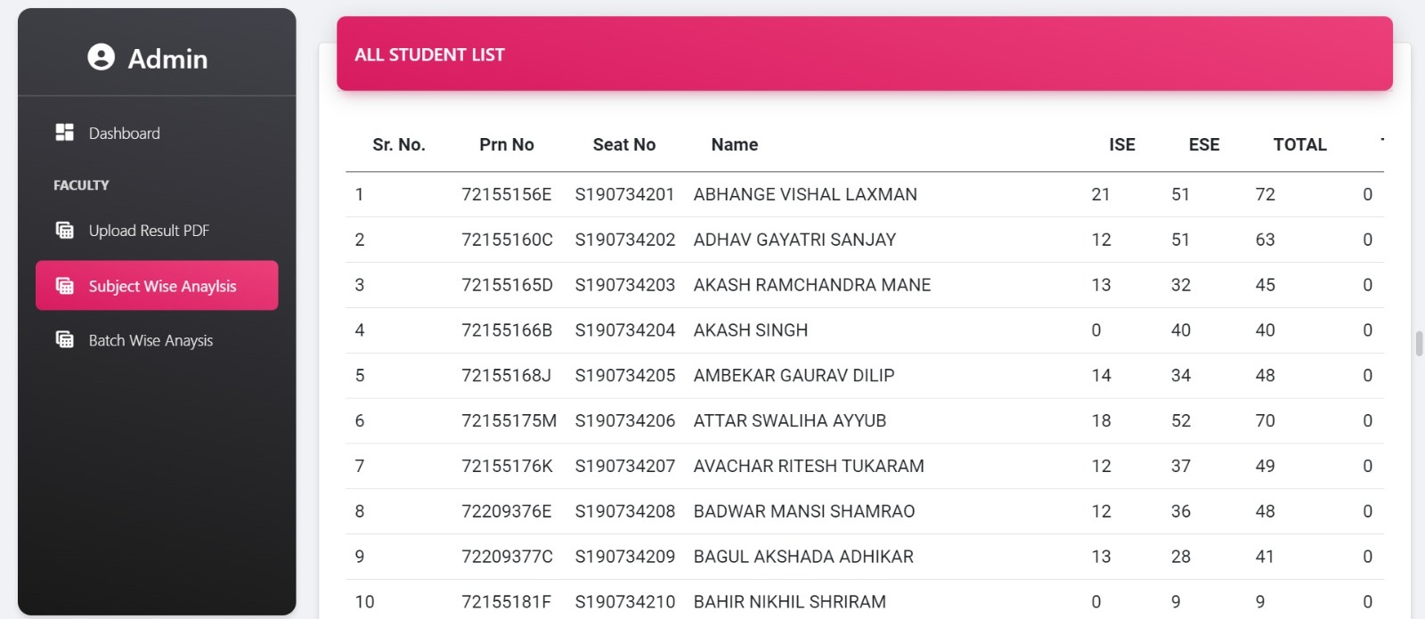

Slide 17
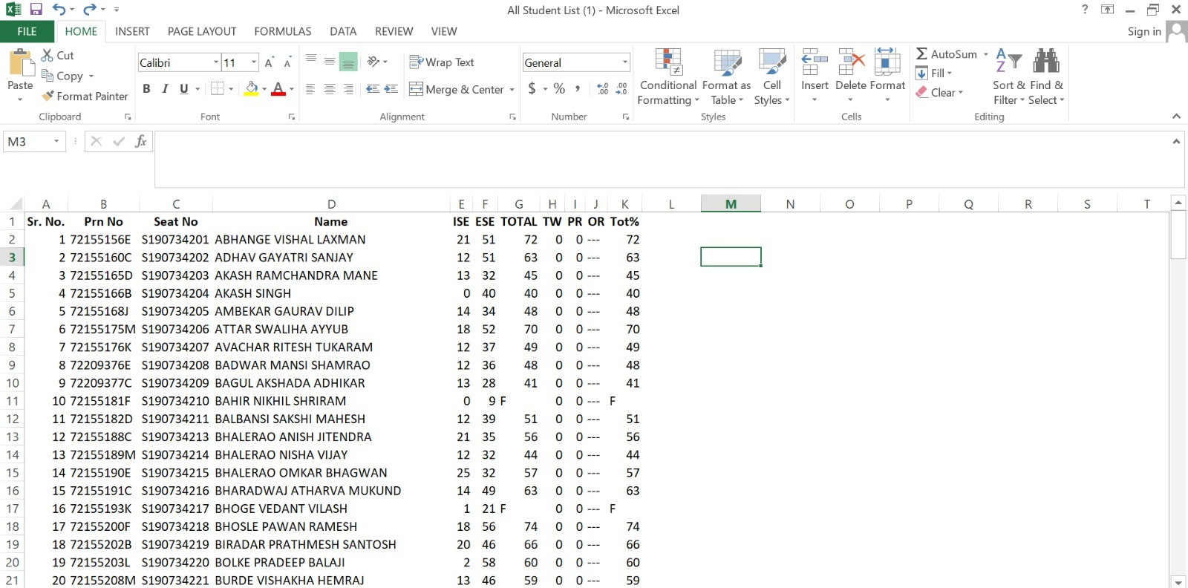

Slide 18
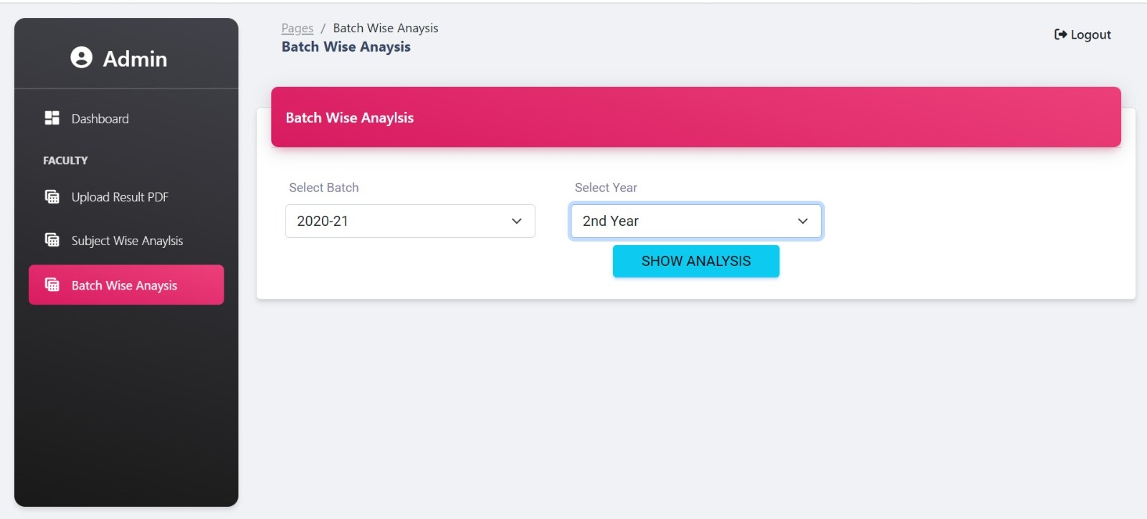

Slide 19
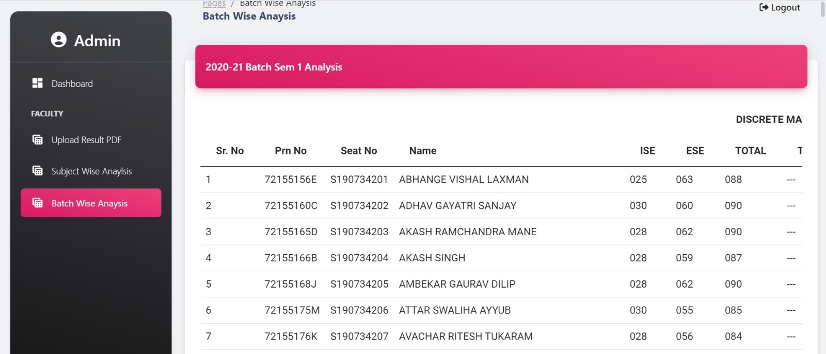

Slide 20
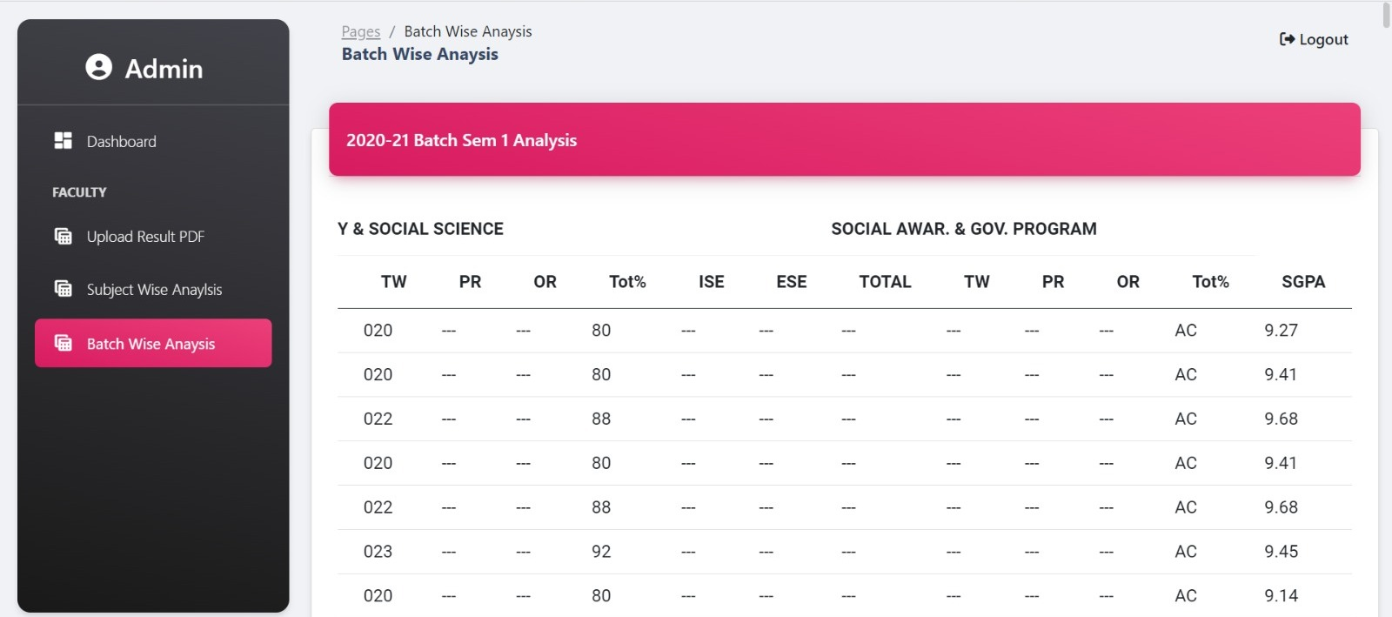

Slide 21
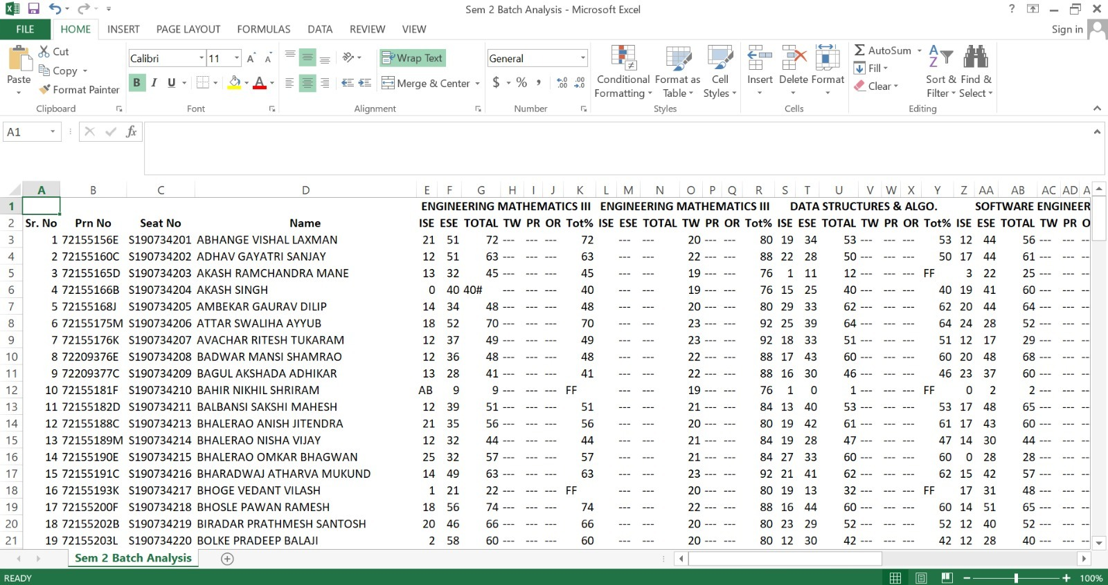

Slide 22
FUTURE ENHANCEMENT
Student Wise Analysis
Uploading Students Achievement
Mobile Application
Advance Analytics

Slide 23
CONCLUSION
The SPPU Result Analysis project successfully aims to revolutionize the result analysis process at our college by transitioning from manual excel-based data entry to an efficient online system. By leveraging modern technologies, such as ConvertAPI and a database management system, we have streamlined the entire workflow and enhanced the accuracy and accessibility of result analysis.

Slide 24
REFERENCES
PHP Documentation : https://www.php.net/docs.php
Bootstrap Documentation : https://getbootstrap.com/docs/4.1/getting-started/introduction/
Geeks For Geeks : https://www.geeksforgeeks.org/php-tutorials/
ConvertAPI Documentation : https://www.convertapi.com/doc

Slide 25
THANK YOU

